Slide 1
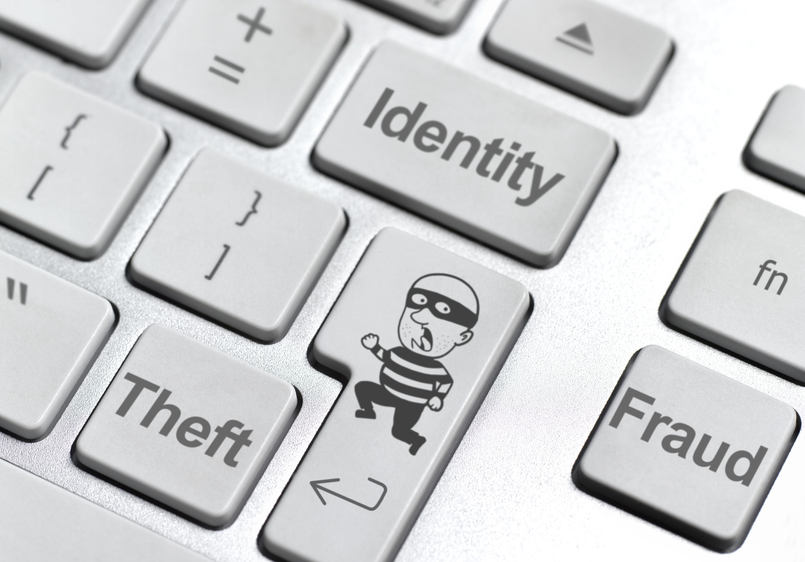
Securing Your System: Protecting Your Digital Data and Devices
Integrated Professional Skills in the Digital Age

Slide 2
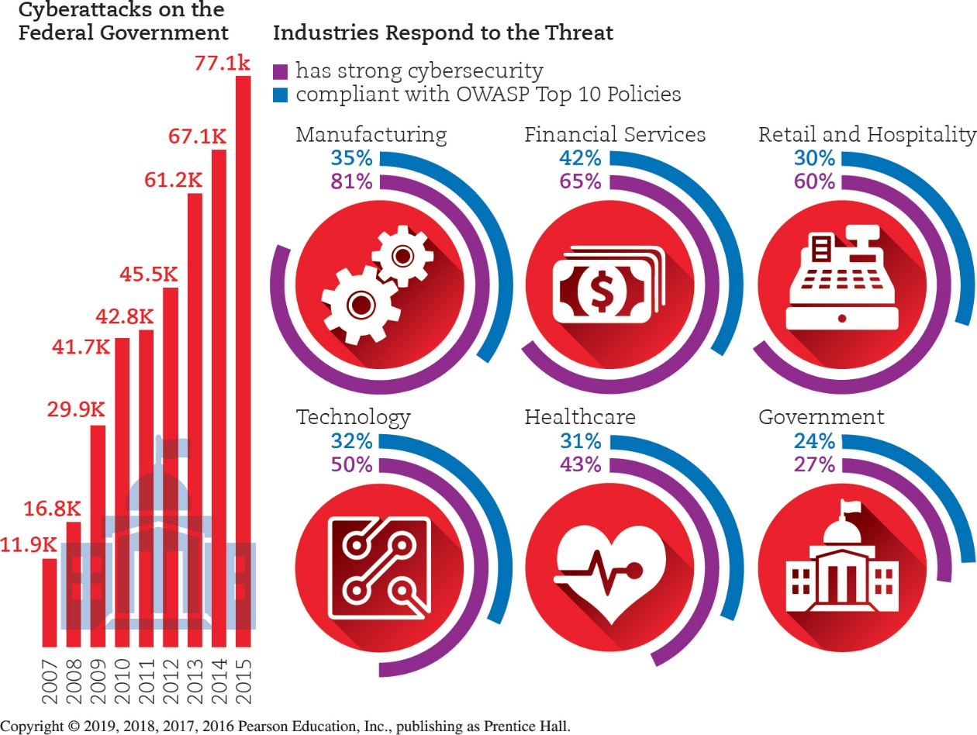
Identity Theft and Hackers
Cybercrime
Cybercriminals
Common types of cybercrimes
FBI-related scams, Identify theft, nonauction/non-delivery of merchandise, advance free fraud
Others like hacking, piracy, and blackmail

Slide 3
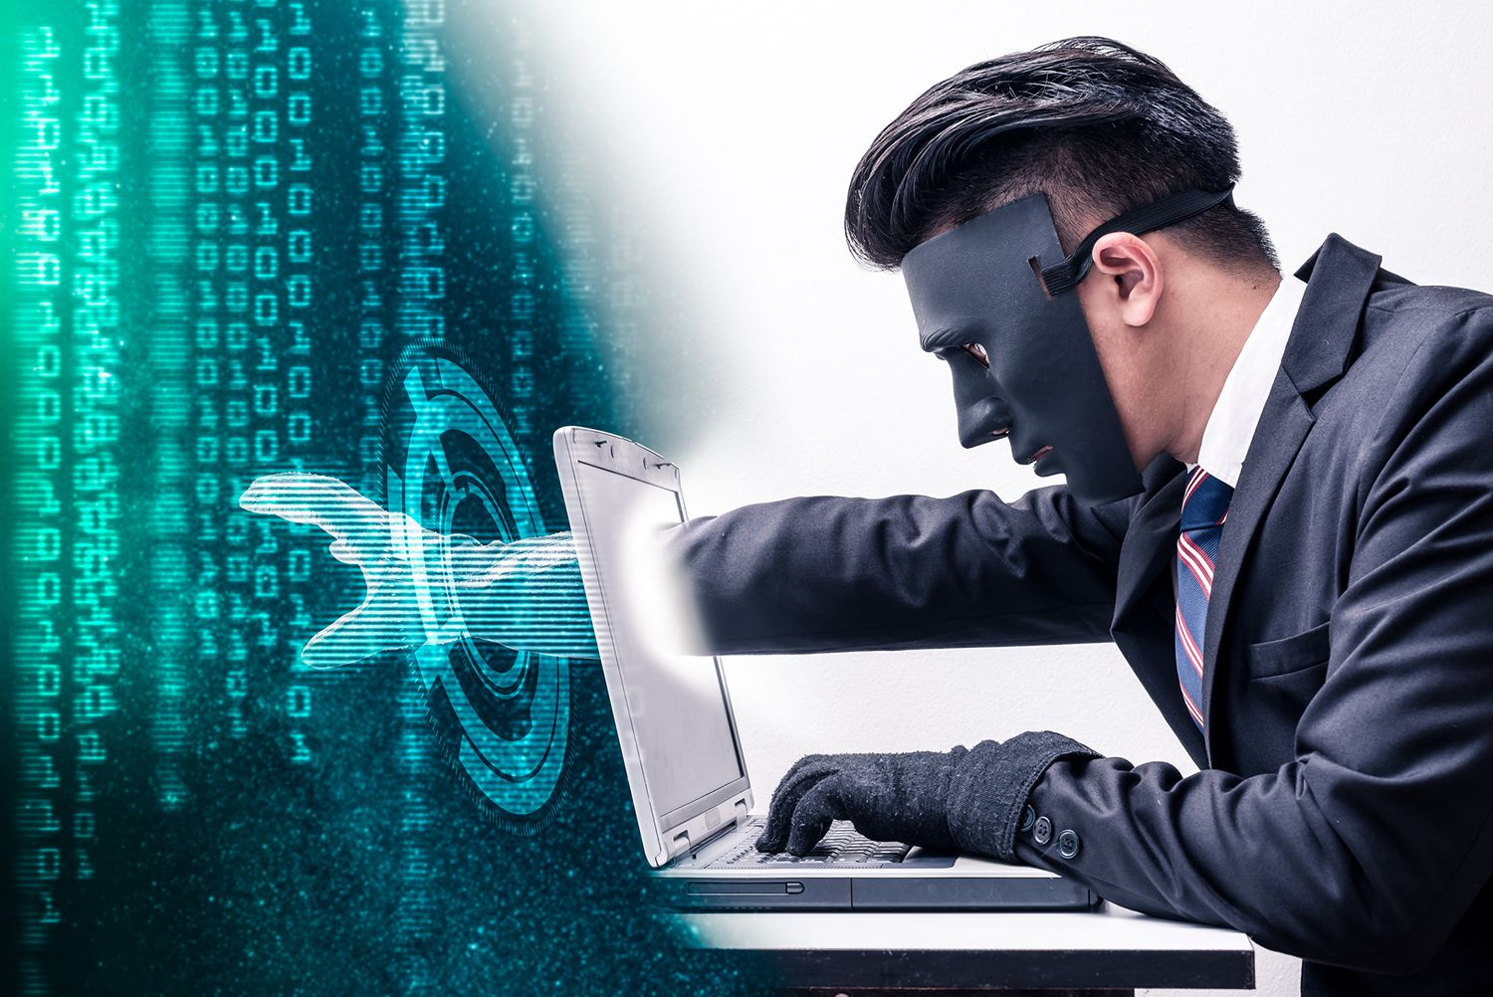
Identity Theft and Hackers Hacking
Federal Trade Commission(FTC) has identified additional methods thieves use to obtain other’s personal information
Stealing purses and wallets
Stealing mail or looking through trash for bank statements and credit card bills
Posing as bank or credit card company representatives and tricking people into revealing sensitive information over the phone
Installing skimming devices on ATM machines that record information, such as account numbers and passcodes

Slide 4
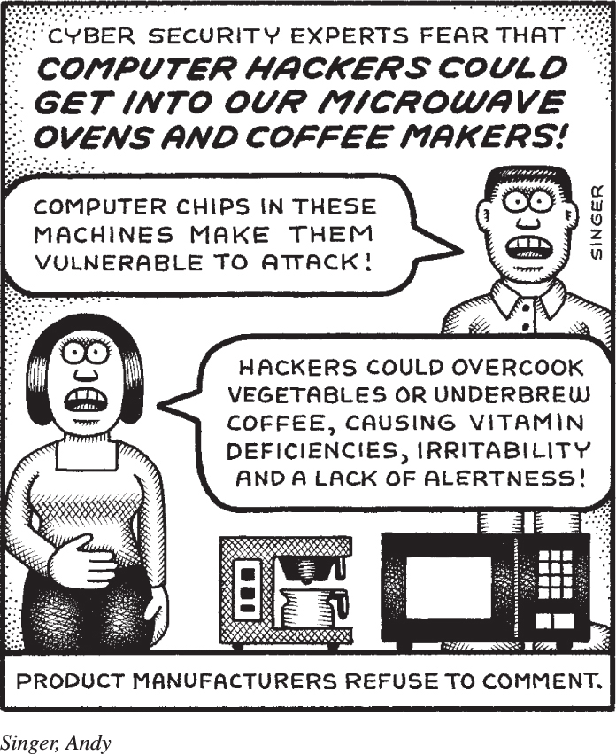
Identity Theft and Hackers
Hacking (1 of 4)
Defined as anyone who unlawfully breaks into a computer system
Types of hackers
White-hat (ethical hackers)
Black-hat hackers
Grey-hat hackers
Packet analyzer (sniffer)
Keylogger

Slide 5
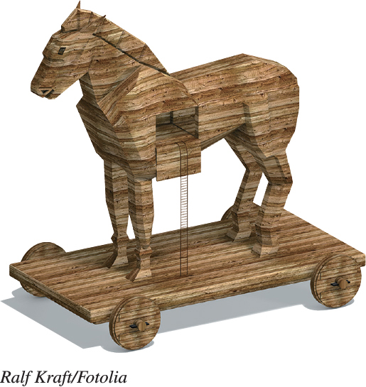
Identity Theft and Hackers Hacking (2 of 4)
Trojan horses appear to be useful but run malicious code
Backdoor programs and rootkits allow hackers to gain access to your computer
Zombies are computers that a hacker controls
Notes:
A Trojan horse is a program that appears to be something useful or desirable, but does something malicious in the background without your knowledge.
Backdoor programs and rootkits are programs that allow hackers to gain access to your computer and take almost complete control of it without your knowledge.
A computer that a hacker controls is referred to as a zombie. Zombies are often used to launch denial-of-service attacks on other computers.

Slide 6
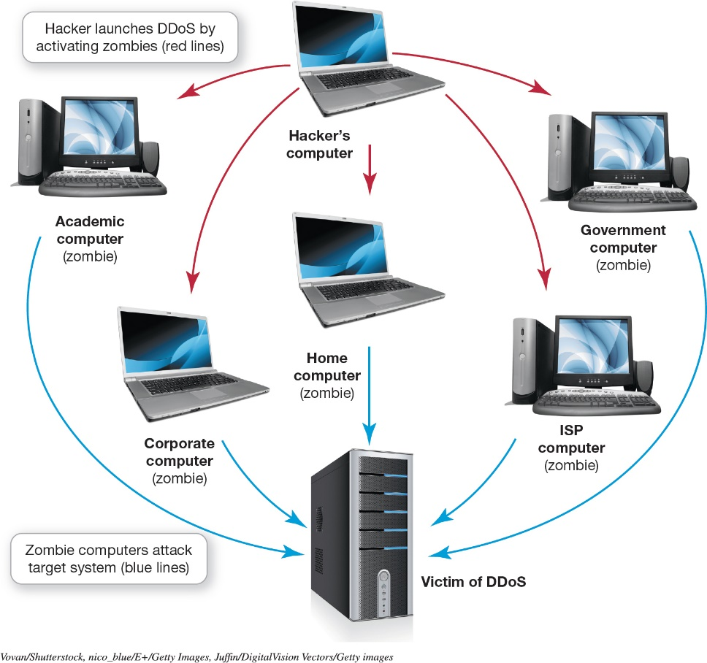
Identity Theft and Hackers Hacking (3 of 4)
Denial-of-Service
Legitimate users are denied access to a computer system
System shuts down
DDoS
Botnet (large group of software running on zombie computers)
Notes:
In a denial-of-service attack, legitimate users are denied access to a system because a hacker is repeatedly making requests of that system through a computer the hacker has taken over as a zombie. A computer can handle only a certain number of requests for information at one time. When it is flooded with requests, it shuts down and refuses to answer any requests for information, even if the requests are from a legitimate user.
A distributed denial-of-service (DDoS) attack launches DoS attacks from more than one zombie at the same time.
A botnet is a large group of software running on zombie computers.

Slide 7
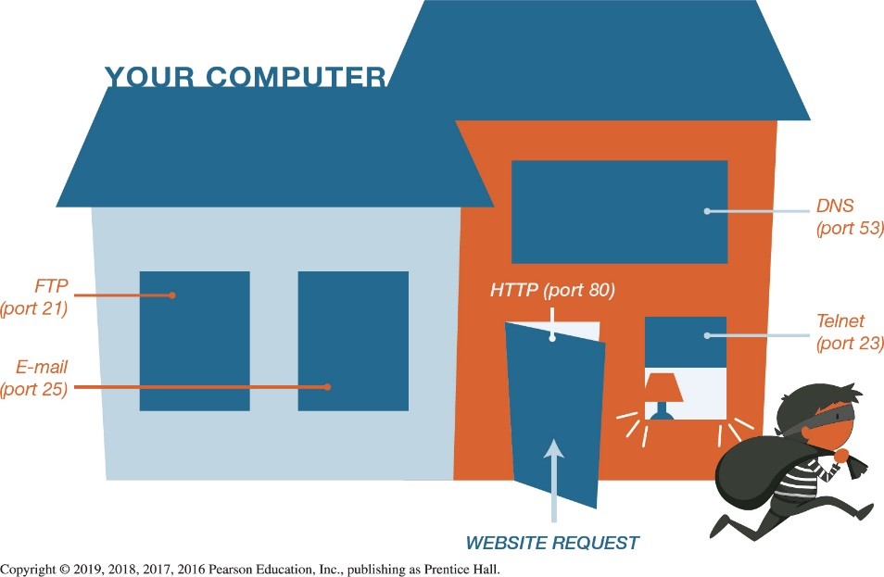
Identity Theft and Hackers Hacking (4 of 4)
How is hacking done?
Many professional hackers use Exploit kits
Exploit kits–software that runs on servers searching for vulnerabilities
Logical ports are virtual, not physical, communications paths
Notes:
Exploit kits are software programs that run on servers searching for vulnerabilities.
Logical ports are virtual, not physical, communications paths.

Slide 8

Computer Viruses Virus Basics
Program that attaches to a computer program to spread to other computers
Main purpose–replicate itself and copy its code into as many other host files as possible
Secondary objectives can be destructive
Smartphones, tablets, and other devices can be infected with viruses
Notes:
A virus is a program that attaches to a computer program to spread to other computers.
Their main purpose is to replicate itself and copy its code into as many other host files as possible.
Secondary objectives can be destructive.
Smartphones, tablets, and other devices can be infected with viruses.

Slide 9
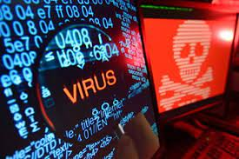
Computer Viruses How to detect virus infection?
If your computer displays any of the following symptoms it may be infected with a virus:
Existing program icons or files suddenly disappear.
You start a browser and it takes you to an unusual home page or it has a new toolbars
Odd messages, pop-ups, or images are displayed on the screen, or strange music or sounds play
Data files may become corrupt
Programs stop working properly
Your system shuts down unexpectedly, slows down or takes a long time to boot up
Notes:
A virus is a program that attaches to a computer program to spread to other computers.
Their main purpose is to replicate itself and copy its code into as many other host files as possible.
Secondary objectives can be destructive.
Smartphones, tablets, and other devices can be infected with viruses.

Slide 10
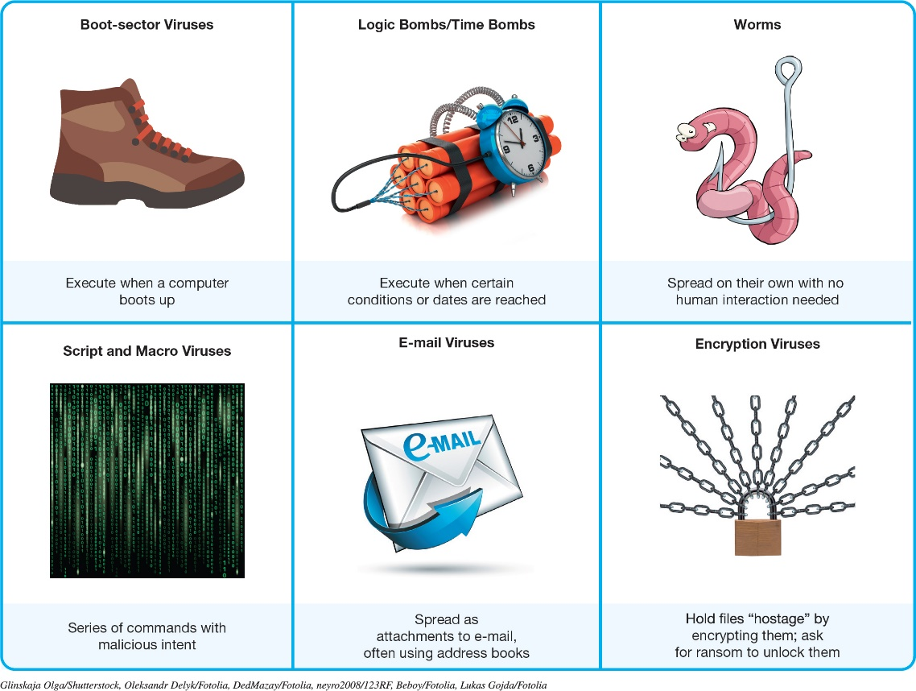
Computer Viruses Types of Viruses (1 of 2)
Boot sector viruses
Logic Bombs and Time Bombs (Michelangelo virus, a time bomb)
Worms (Code Red, MSBlast)
Script and macro viruses
Melissa Macro virus
Email viruses
Melissa virus
Encryption viruses (ransomware)
Notes:
Viruses can come in many types, including:
Boot sector viruses.
Logic Bombs and Time Bombs.
Worms.
Script and macro viruses.
Email viruses.
Encryption viruses.
Figure 9.7 summarizes the major types of viruses.

Slide 11
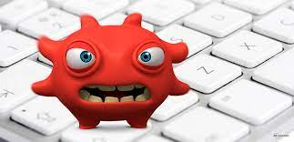
Computer Viruses Types of Viruses (2 of 2)
Classified by methods used to avoid detection
Polymorphic viruses changes their code or periodically rewrites themselves to avoid detection
Multipartite viruses are designed to infect multiple file types
Stealth viruses temporarily erase their code from the files where they reside and hide in active memory
Notes:
Viruses can be classified by the methods they take to avoid detection:
A polymorphic virus changes its code to avoid detection. Most polymorphic viruses infect a particular type of file.
A multipartite virus is designed to infect multiple file types in an effort to fool the antivirus software that is looking for it.
Stealth viruses temporarily erase their code from the files where they reside and hide in the active memory of the computer.

Slide 12
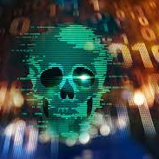
Online Annoyances and Social Engineering Online Annoyances (1 of 3)
Malware has malicious intent
Adware displays sponsored advertisements
Spyware is an unwanted piggy-back program
Transmits information
Tracking cookies
Keystroke logger
Many anti-spyware packages are available
Anti-Malware, Ad-Aware, Spybot
Notes:
Malware is software that has a malicious intent.
Adware displays sponsored advertisements.
Spyware is an unwanted program that downloads with other software from the Internet and runs in the background.
Spyware transmits information about you.
Many spyware programs use tracking cookies.
A keystroke logger program monitors keystrokes.
Other anti-spyware programs are easy to install and update.

Slide 13
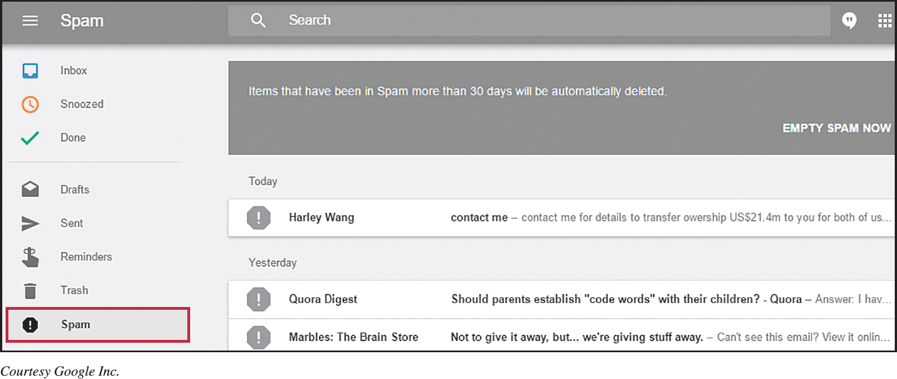
Online Annoyances and Social Engineering Online Annoyances (2 of 3)
Spam (junk e-mail)
Tactics to minimize spam (spam filter)
Create and use secondary email so that account could be deleted when it reaches a saturated point
Notes:
Spam is unwanted or junk e-mail.
There are several ways to help avoid spam:
Create a free e-mail address
Spam filters
Buy third-party programs
Reclassify e-mails that have been misidentified as spam

Slide 14
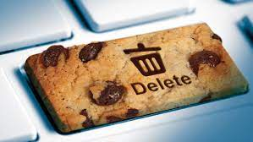
Online Annoyances and Social Engineering Online Annoyances (3 of 3)
Cookies are small text files received when you visit a website
Help companies determine the effectiveness of their marketing
Do not search your hard drive for personal information
May invade your privacy
Pose no security threat
Notes:
Cookies are small text files that some websites automatically store on your hard drive when you visit them.
Companies use this information to determine the traffic flowing through their website and the effectiveness of their marketing strategy.
Cookies do not go through your hard drive in search of personal information.
The main concern is that advertisers will use this information indiscriminately, thus invading your privacy.
Cookies pose no security threat because it is virtually impossible to hide a virus or malicious software program in a cookie.

Slide 15
Online Annoyances and Social Engineering Social Engineering (1 of 3)
Social engineering is any technique using social skills to generate human interaction
Entices individuals to reveal sensitive information
Pretexting involves creating a scenario that sounds legitimate
Notes:
Social engineering is any technique using social skills to generate human interaction with the purpose of enticing individuals to reveal sensitive information.
Pretexting involves creating a scenario that sounds legitimate.

Slide 16
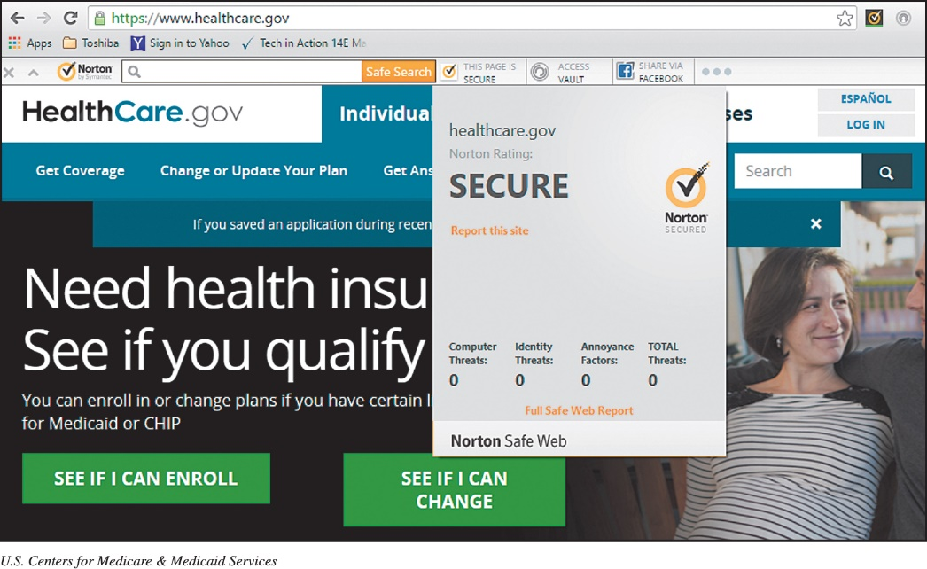
Online Annoyances and Social Engineering Social Engineering (2 of 3)
THREE forms of social engineering
Phishing
Luring people into revealing information
Pharming
Malicious code planted on your computer to gather information
Scareware
Type of malware
Attempts to convince you something is wrong … and to pay money to fix it
Encrypting your files and demand money for decrypting
Notes:
Phishing lures Internet users to reveal personal information.
Pharming occurs when malicious code is planted on your computer.
These guidelines help to avoid such schemes:
Never reply directly to any e-mail asking for personal information.
Don’t click on a link in an e-mail.
Check with the company asking for information.
Never give personal information over the Internet unless you know the site is secure.
Use phishing filters.
Use Internet security software that’s constantly being updated.

Slide 17
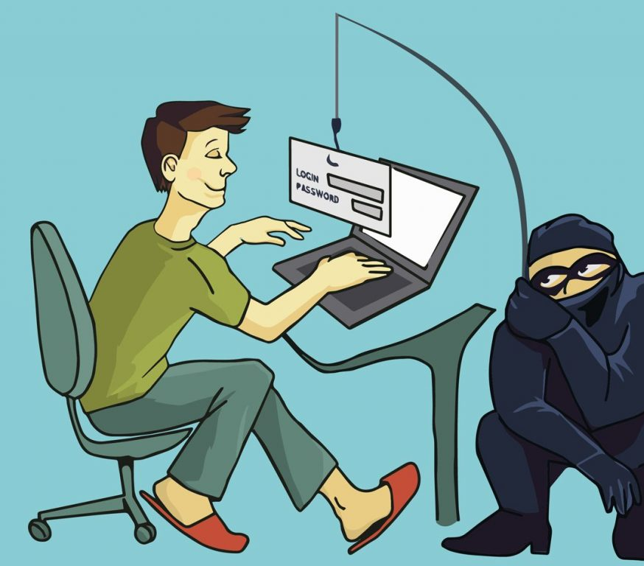
Online Annoyances and Social Engineering Social Engineering (3 of 3)
Guidelines to avoid schemes
Never reply directly to any e-mail asking for personal information or click on some website banners, pop-up boxes
Do not click on a link in an email
Check with the company asking for information
Never give personal information over the internet unless you know the site is secure
Use phishing filters and internet security software, like McAfee, Norton etc.
Notes:
Phishing lures Internet users to reveal personal information.
Pharming occurs when malicious code is planted on your computer.
These guidelines help to avoid such schemes:
Never reply directly to any e-mail asking for personal information.
Don’t click on a link in an e-mail.
Check with the company asking for information.
Never give personal information over the Internet unless you know the site is secure.
Use phishing filters.
Use Internet security software that’s constantly being updated.

Slide 18
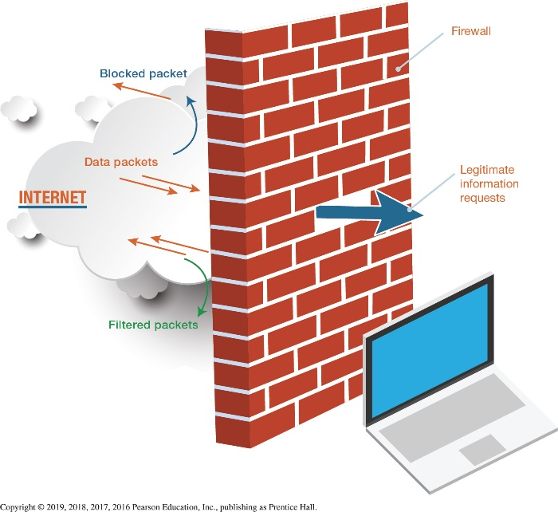
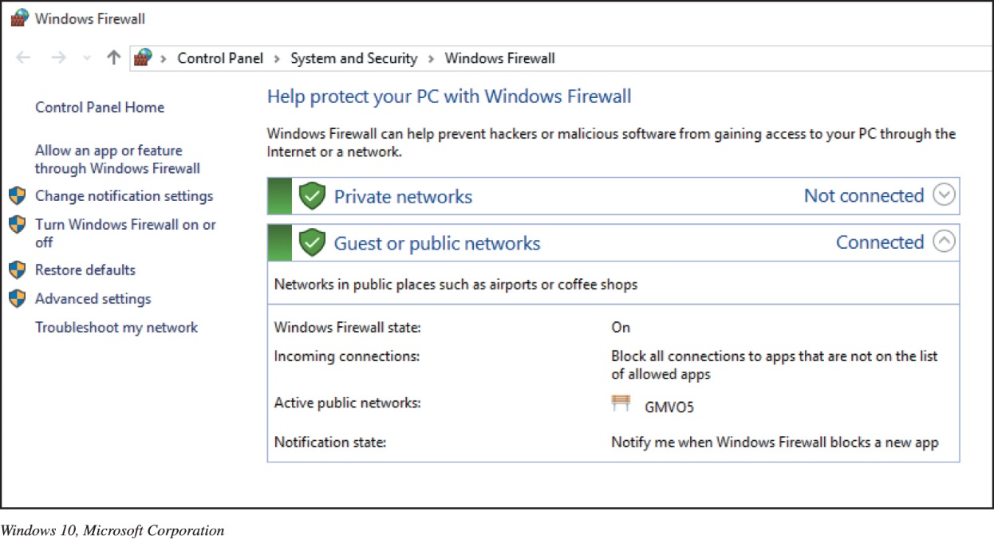
Restricting Access to Your Digital Assets Firewalls (1 of 2)
Firewall—hardware or software
Windows and macOS include firewalls
Security suites(Norton, McAfee, ZoneAlarm) include firewall software
Notes:
A firewall is a software program or hardware device designed to protect computers from hackers.
Both Windows and macOS include reliable firewalls. The Windows Action Center is a good source of information about the security settings on your computer, including the status of your firewall.
Security suites such as Norton Internet Security, McAfee Internet Security, and ZoneAlarm Internet Security Suite also include firewall software.

Slide 19
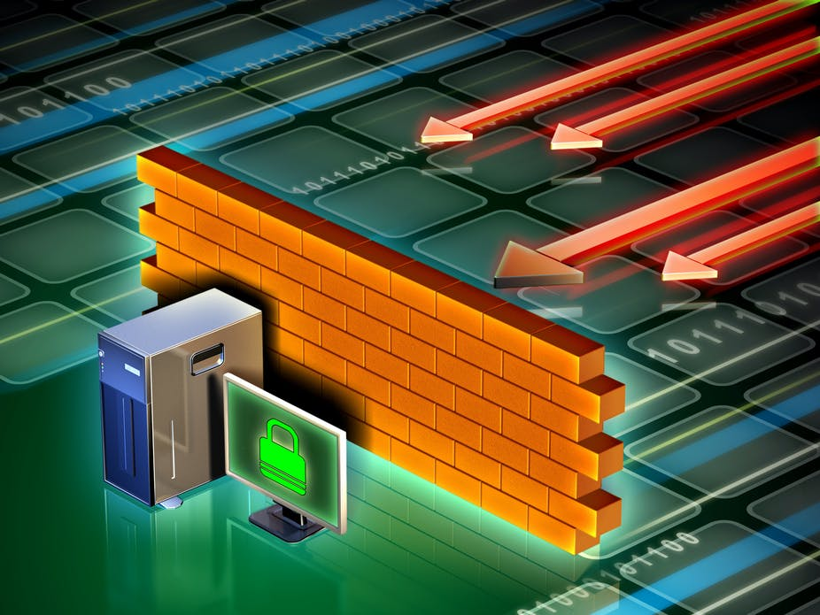
Restricting Access to Your Digital Assets Firewalls (2 of 2)
Packet filtering
Filter out packets sent to logical ports
Logical port blocking
Completely refuses requests from the Internet asking for access to specific ports
Network address translation(NAT)
Assign internal IP addresses on a network
With a NAT-capable router/firewall installed on your network, hackers are unbale
Notes:
Firewalls can be configured so that they filter out packets sent to specific logical ports in a process known as packet filtering.
Firewalls can also be configured to completely refuse requests from the Internet asking for access to specific ports in a process known as logical port blocking.
Firewalls use a process called network address translation (NAT) to assign internal IP addresses on a network.

Slide 20
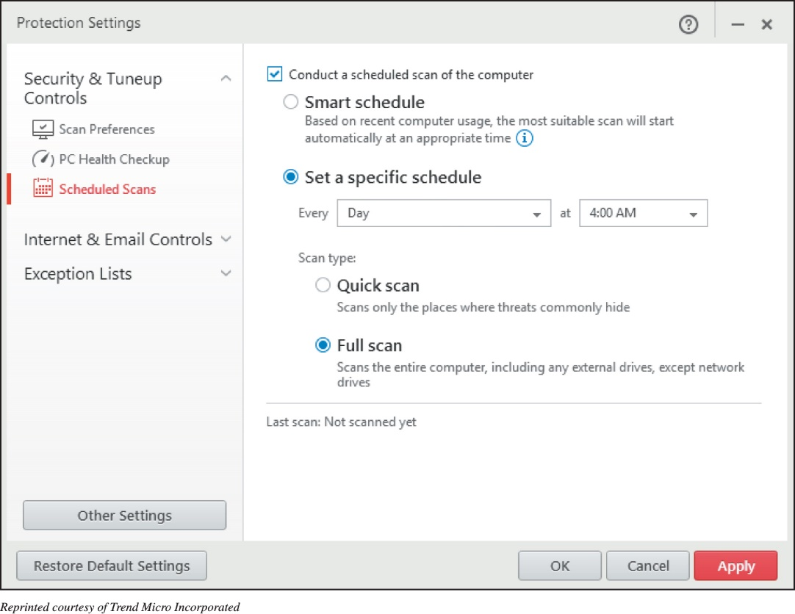
Restricting Access to Your Digital Assets Preventing Virus Infections (1 of 3)
Antivirus software
Detects viruses and protects your computer
Popular programs
Symantec
Kaspersky
Trend Micro
Avast
360 Security
Notes:
Antivirus software is specifically designed to detect viruses and protect your computer and files from harm. Symantec, Kaspersky, Trend Micro, and Avast are among the companies that offer highly rated antivirus software packages.

Slide 21
Restricting Access to Your Digital Assets Preventing Virus Infections (2 of 3)
Virus signature
Portion of the virus code that’s unique to a particular computer virus
Quarantining
Placing virus in a secure area so it won’t spread to other files
Inoculation
Records key attributes about your computer files and keep stats in secure place
Notes:
A virus signature is a portion of the virus code that’s unique to a particular computer virus.
Quarantining involves placing virus in a secure area so it won’t spread to other files.
During inoculation, key attributes about your computer files are recorded and keep stats in secure place.

Slide 22
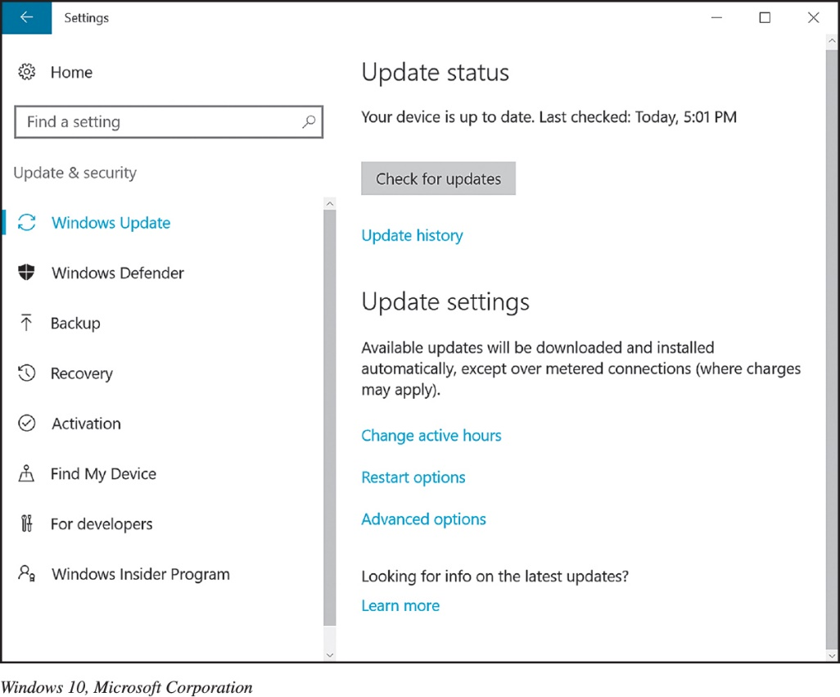
Restricting Access to Your Digital Assets Preventing Virus Infections (3 of 3)
Drive-by download
Exploit weaknesses in operating systems
Notes:
Many viruses exploit weaknesses in operating systems. This type of attack, known as a drive-by download, affects almost 1 in 1,000 web pages.

Slide 23
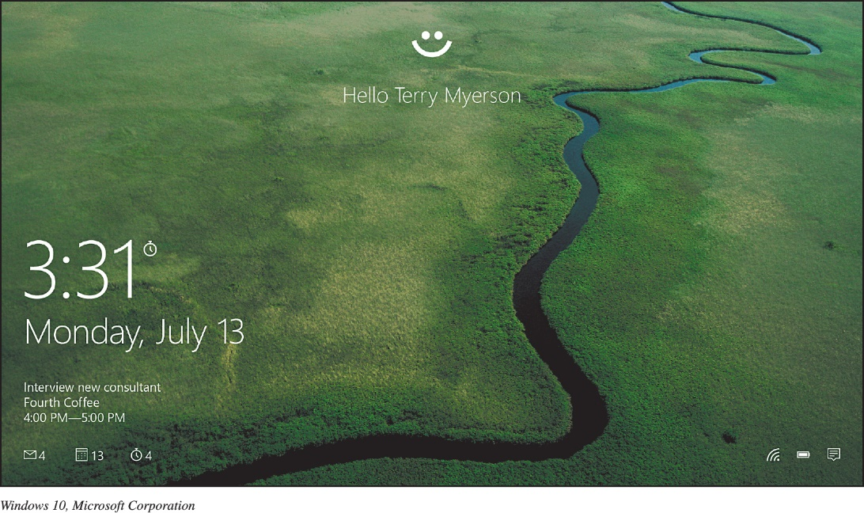
Restricting Access to Your Digital Assets Authentication: Passwords and Biometrics (2 of 2)
Biometric Authentication Devices
Fingerprint
Iris pattern in eye
Voice authentication
Face pattern recognition
Provide a high level of security
Notes:
A biometric authentication device is a device that reads a unique personal characteristic such as a fingerprint or the iris pattern in your eye and converts it to a digital code.
Because no two people have the same biometric characteristics, these devices provide a high level of security.
Other biometric devices, including voice authentication and facial recognition systems, are now widely offered in notebook computers, tablets, and smartphones.

Slide 24
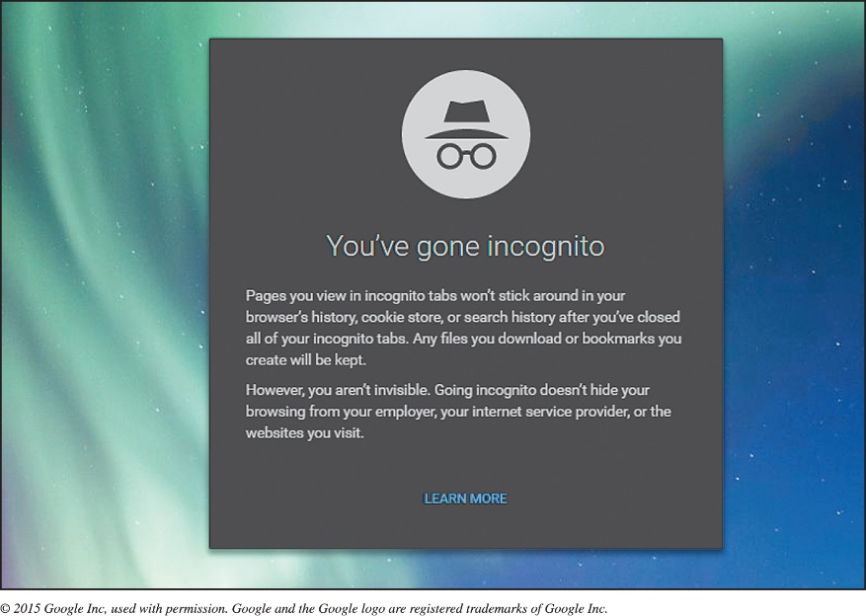
Restricting Access to Your Digital Assets Anonymous Web Surfing: Hiding from Prying Eyes
Privacy tools
Private Browsing
InPrivate
Incognito
Portable privacy devices
Kingston/IronKey Personal Flash Drives
Take the Linux OS with you on a flash drive and avoid using the public or work computer’s OS (pendrivelinux.com)
Virtual private networks (VPNs)
Secure networks that are established using the public Internet infrastructure
Notes:
Privacy tools connected with web browsers include:
Private Browsing.
InPrivate.
Incognito.
Portable privacy devices are available, for example:
Kingston Personal Flash Drives.
Virtual private networks (VPNs) are secure networks that are established using the public Internet infrastructure.

Slide 25
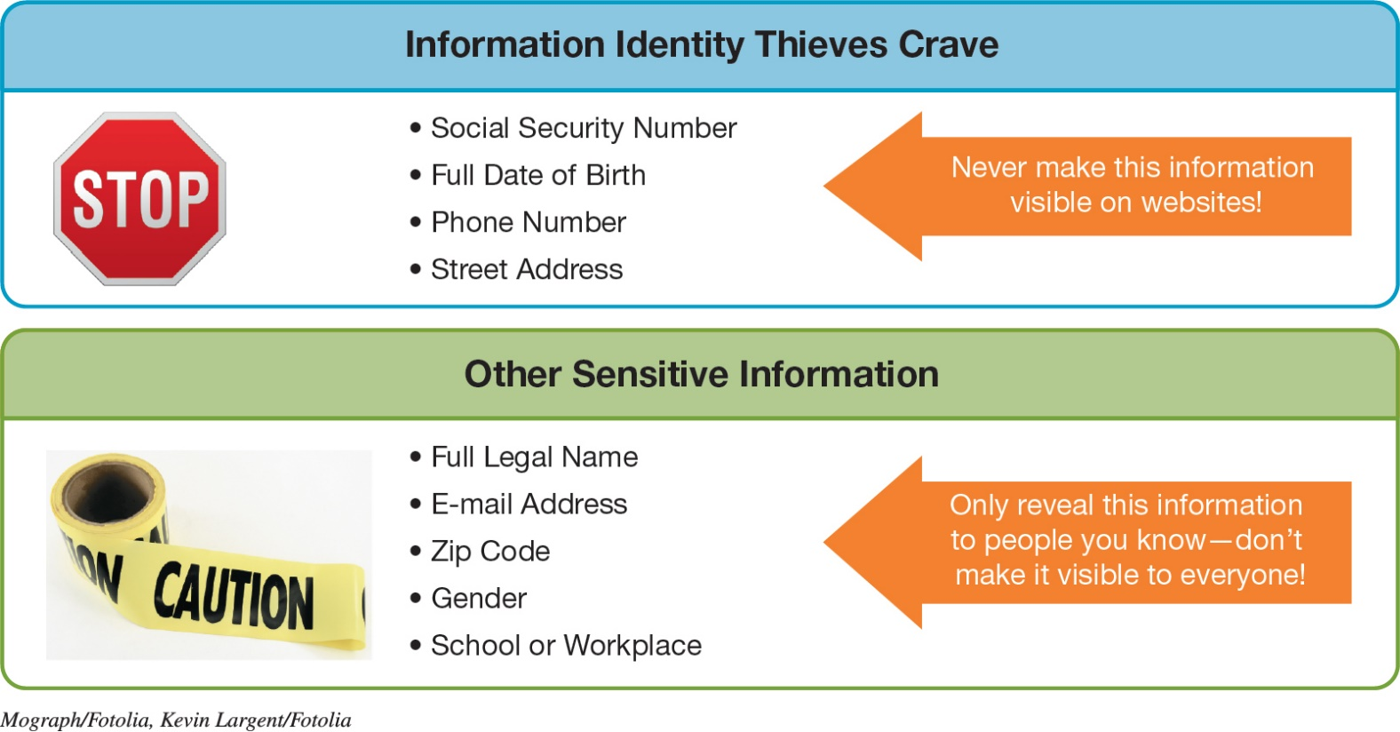
Keeping Your Data Safe Protecting Your Personal Information
Reveal as little information as possible
In Facebook, change your privacy settings, do not depend on default setting
Notes:
Reveal as little information as possible in social media.
In Facebook, change your privacy settings.
Figure 9.30 shows Internet Information-Sharing precautions.

Slide 26
Keeping Your Data Safe Backing Up Your Data (1 of 2)
Remote Backups
Files to backup
Data files
Program files
Types of backups
Full
Incremental
Image
Use secure cloud back for important document
Consider personal cloud backup
Notes:
Backups are copies of files used to replace the originals if they’re lost or damaged.
Files to backup include:
Data files.
Program files.
Types of backups include:
Full.
Incremental.
Image.

Slide 27
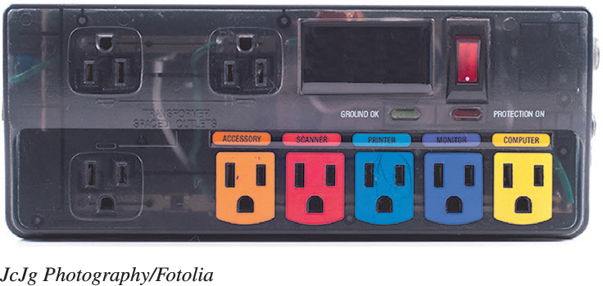
Protecting Your Physical Computing Assets Environmental Factors and Power Surges
Power surges
Old or faulty wiring
Downed power lines
Lightning strikes
Malfunctions at electric company substations
Surge protector / Whole-house surge protector
Replace every 2–3 years
Use with all devices that have solid-state components
Notes:
Power surges occur when an electrical current is supplied in excess of normal voltage. Old or faulty wiring, downed power lines, malfunctions at electric company substations, and lightning strikes can all cause power surges.
A surge protector protects your computer.
Replace surge protectors every 2–3 years or after a major surge.
All electronic devices that have solid-state components, such as TVs, stereos, printers, and cell phones should be connected to a surge protector.

Slide 28
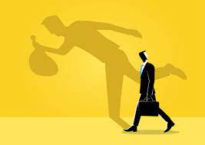
Protecting Your Physical Computing Assets Preventing and Handling Theft
Three main security concerns with mobile devices:
Keeping them from being stolen
Keeping data secure in case they are stolen
Finding a device if it is stolen
Notes:
You have three main security concerns with mobile devices:
Keeping them from being stolen.
Keeping data secure in case they are stolen.
Finding a device if it is stolen.

Slide 29

Questions ?

